Slide 1

Analysis 1: Foundations of Modeling Lesson 1.1: Introduction to Computer Science
Analysis Team, 2020/2021

Slide 2
Welcome to Analysis 1 (course overview)
Theory:
Introduction to computer science
Numeral systems
Boolean logic (part 1)
Boolean logic (part 2)
Sets (pat 1)
Sets (part 2)
Practical lessons
Algorithms, flowcharts, Python setup
Variables, linear algorithms
Branching algorithms
Cyclic algorithms – while loop
Cyclic algorithms – for loop, sets, indexes
Lists in Python

Slide 3
Overview of this lesson: Introduction to computer science
Basic terminology
Data and information
Information science and computer science
Computer
What is a computer?
Hardware and software
Software types
Analog and digital information
Representing information
Advantages and disadvantages of analog / digital
Encoding and decoding information

Slide 4
Overview of this lesson: Introduction to computer science
Learning objectives:
Adapt the basic terminology (data, information, information system, …)
Understand the components of a computer and its basic operations
Understand what is software and different types of software
Understand what is analog and digital information and the differences between them
At the end of the lesson a student should be able to:
Explain the above-mentioned terms

Slide 5
Computation and the Analysis line

Slide 6
Computation
Computation is a general term for any type of information processing.
It describes phenomena that can range:
From very broad like human thinking,
To a very specific calculation.
Definition (from Wikipedia): Computation is a process following a well-defined model that is understood and can be expressed in an algorithm, protocol, network topology, etc.

Slide 7
Computation in the Analysis line
PROBLEM SOLVING
KNOWLEDGE OF CONCEPTS
PROGRAMMING

Slide 8
Computation in the Analysis line
Problem solving:
The ability to take a given problem description and write an original solution (program).
A vital skill that develops over time with deliberate practice and effort.
Requires foundation in scientific disciplines like: logic and mathematics.
PROBLEM SOLVING
KNOWLEDGE OF CONCEPTS
PROG.
SKILL

Slide 9
Computation in the Analysis line
Programming skill:
Writing (implementing) an original program using previously learned tools and skills.
Includes learning of:
Programming syntax,
Reading and writing programs,
Debugging programs,
Using various APIs (application programming interfaces).
The main focus of the Development line.
In Analysis, we will provide you the essentials to get the job done, but don’t go into details.
PROBLEM SOLVING
KNOWLEDGE OF CONCEPTS
PROG.
SKILL

Slide 10
Computation in the Analysis line
Knowledge of concepts:
Understanding the technological constraints and determining how can the solution work within the given environment.
Example:
What is an OS (operating system), what does it do and how does it work?
What is a network protocol? How to send and receive data from and to a remote system?
Etc.
PROBLEM SOLVING
KNOWLEDGE OF CONCEPTS
PROG.
SKILL

Slide 11
Course book
“Introduction to Computation and Programming Using Python”, John V. Guttag
Chapters: 1, 2, 3, 5.1, 5.4
Used at MIT for the course 6.0001 – Introduction to Computer Science and Programming in Python
(fast paced course)
Feel free to explore the course for extra materials (videos, slides, code).
Notes:
Copy-pasted link to the course 6.0001 – Introduciton to Computer Science and Programming in Python:
https://ocw.mit.edu/courses/electrical-engineering-and-computer-science/6-0001-introduction-to-computer-science-and-programming-in-python-fall-2016/

Slide 12
Basic terminology
Data, information,
Information science, informatics, computer science

Slide 13
Data and information
Data is defined as a representation of facts, concepts, or instructions in a formalized manner, suitable for communication, interpretation, or processing by a human or a computer.
Information is the processed data that is:
Accurate and timely,
Specific and organized for a purpose,
Presented within a context that gives it meaning and relevance,
Can lead to an increase in understanding and decrease in uncertainty.

Slide 14
Information science
Information science – a scientific field that studies information systems, or more precisely information-related activities such as:
Information analysis (characteristics, meaning of the information)
Information collection (how to acquire?)
Information classification (how to organize inf. into categories)
Information storage (how to save and later load information; effectively (e.g. cheap) and reliably)
Information transfer (make communication reliable and fast)
Information manipulation (ability to transform information (e.g. calculate average))
Information dissemination (how to publish information?)
Information protection (how to prevent unauthorized access (e.g. cryptography))

Slide 15
Information science (Informatics)
Informatics is an applied form of Information science.
Informatics involves:
Information processing
Engineering of information systems
The key characteristics of Information systems are its abilities to acquire, transform (thus increasing value) and exchange information.
This is requirement for any technological advancement.

Slide 16
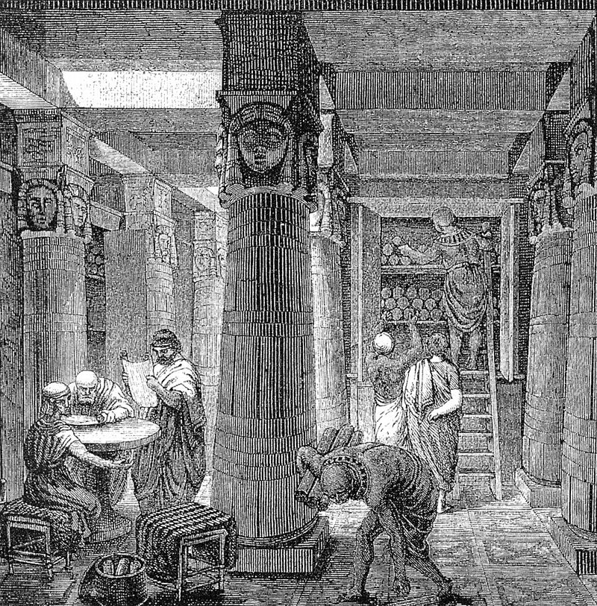
Information science
Information system ≠ computer system
Although the most efficient way to realize information system is by using computers and computer networks, information systems can be based on card-catalogue, courier service, manual information processing, etc.
The ancient Library of Alexandria is an early example of information system.

Slide 17
Computer science
Computer science – is a set of skills and knowledge about technologies focusing on development, programming and use of computers.
Computer science focuses on hardware and software.
Computer Science consists of several fields such as: software engineering, networks, computer systems, databases, programming languages, security, artificial intelligence and many more.
Essentially: Computer Science deals with all practical activities related to information.

Slide 18
What is a computer?
Hardware and software

Slide 19
Computer
A computer is a device that manipulates information, or data. It has the ability to retrieve, store, process and send data.
In simple terms: computers “crunch” numbers – perform calculations, and they do it, from human’s perspective, very fast.
Billions of calculations per second.
Remember results.

Slide 20
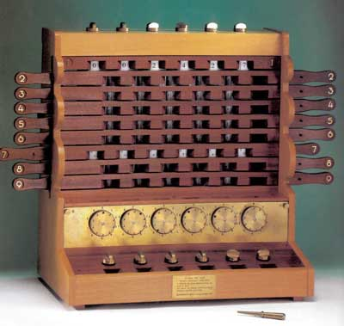
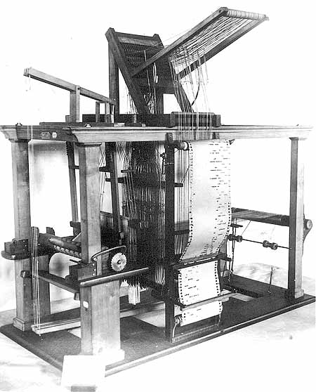
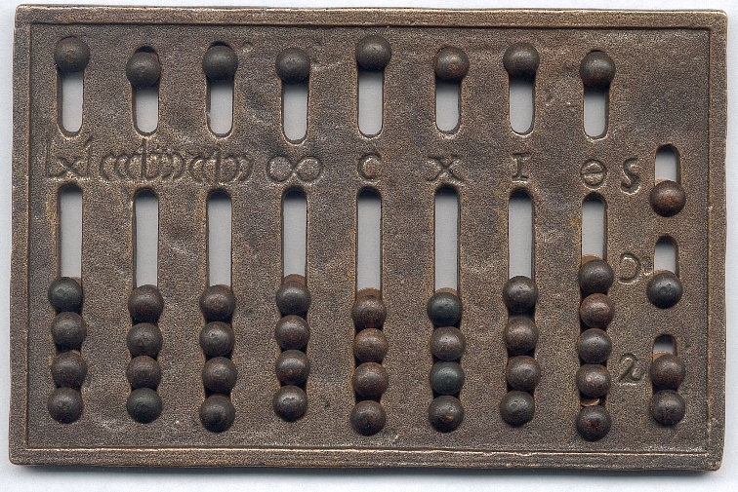
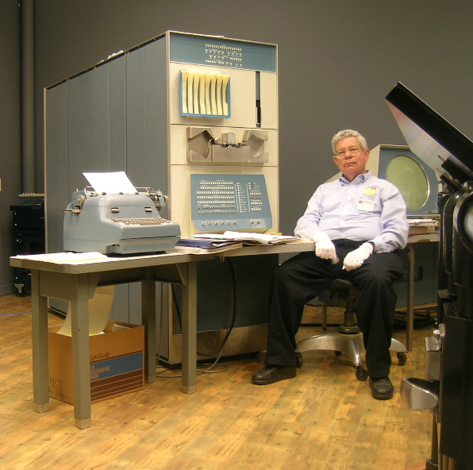

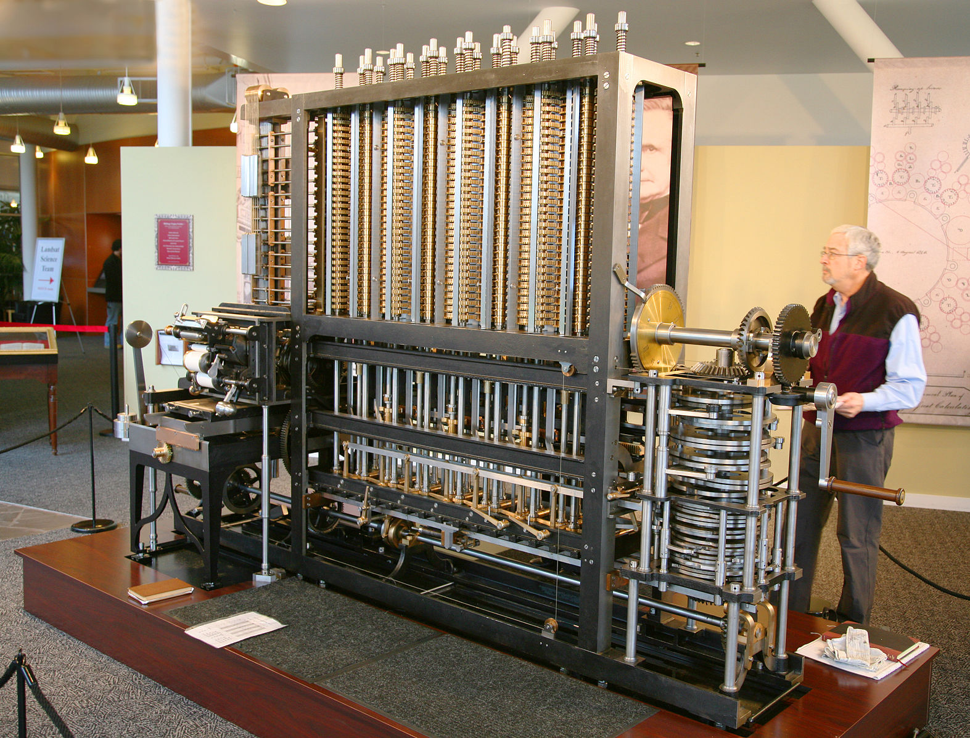
Early computers
Selected mechanical computers:
Abacus (2600 BC)
Calculating clock (Wilhelm Schickard, 1623)
Jacquard loom (Joseph-Marie Jacquard, 1804)
Differential engine (Charles Babbage, 1822)
Selected electrical computers:
Eniac (1944)
* invention of transistor (1948)
PDP-1 (1960)
Notes:
Image sources:
Abacus - www.sliderulemuseum.com/Abaci.htm
Schickard’s clock - https://history-computer.com/MechanicalCalculators/Pioneers/Schickard.html
Jacquard loom - https://encyclopedia2.thefreedictionary.com/
Differential engine - https://commons.wikimedia.org/wiki/File:Babbage_Difference_Engine_(the_power-supply_end).jpg
Eniac - https://en.wikipedia.org/wiki/ENIAC
PDP-1 - https://en.wikipedia.org/wiki/PDP-1

Slide 21
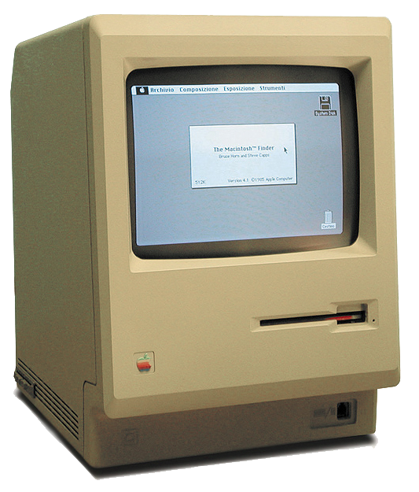
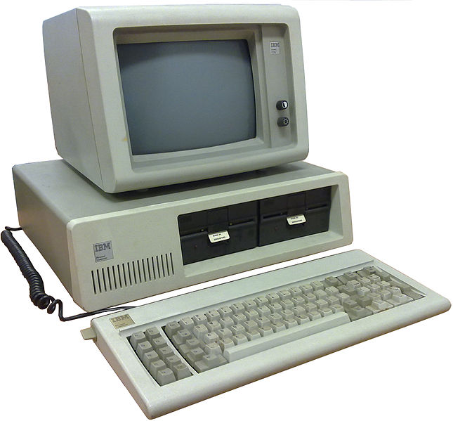
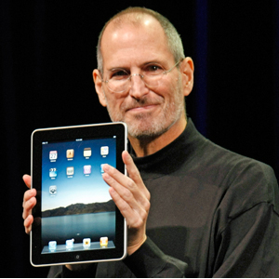
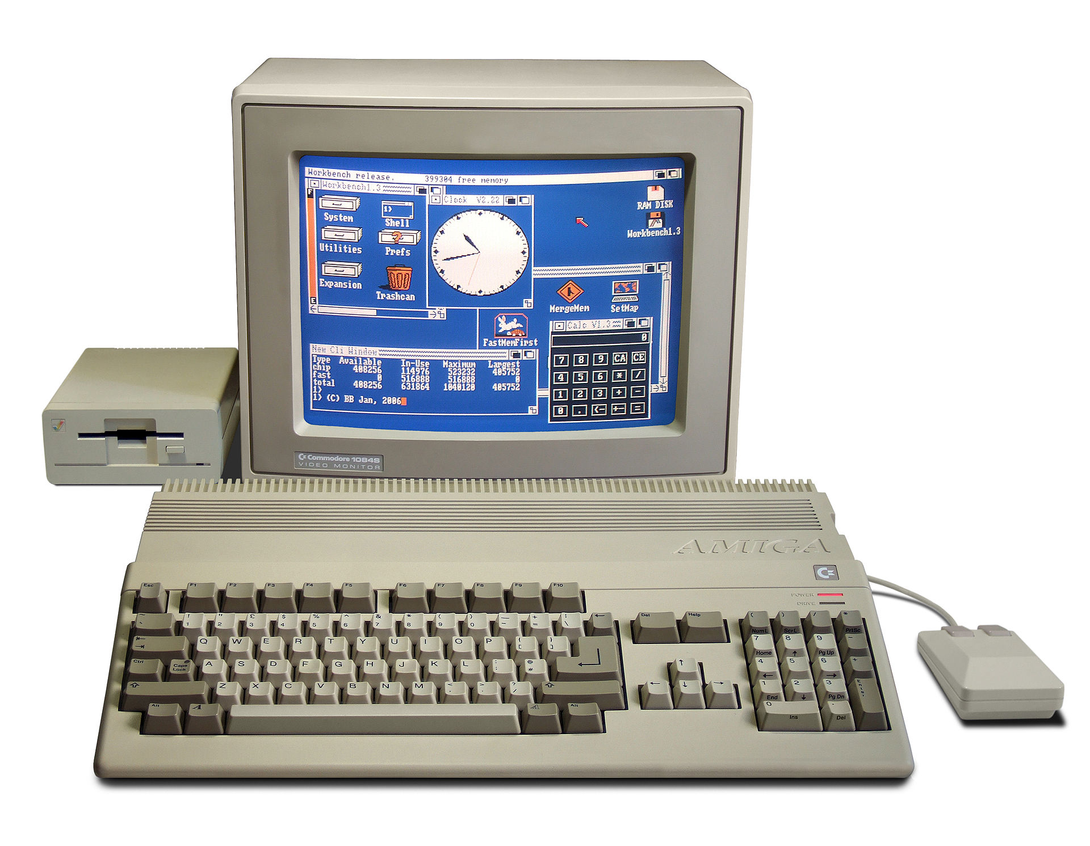
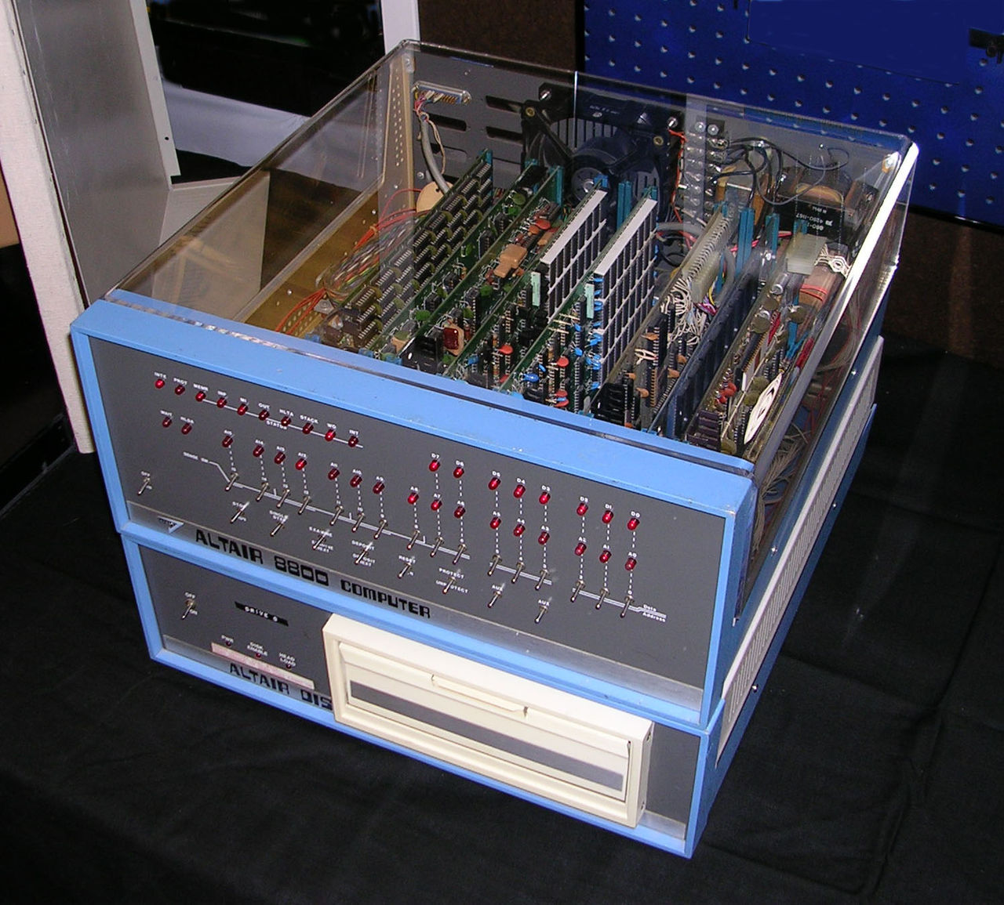
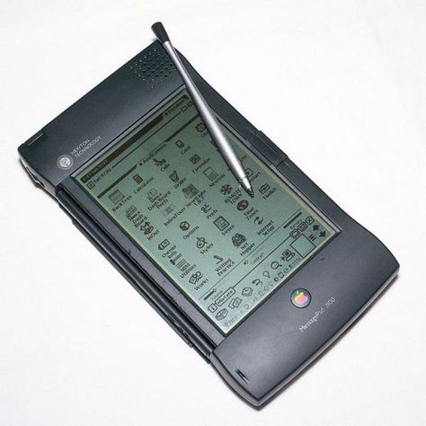
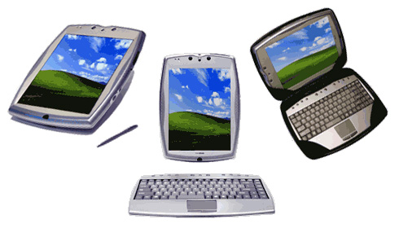
Personal computers
Selected personal computers:
Altair 8800 (1974)
IBM PC, model 5150 (1981)
Apple Macintosh (1984)
Commodore Amiga 500 (1986)
Apple Newton (1992)
PaceBook (2000)
Apple iPad (2010)
Notes:
Image sources:
Altair 8800 – https://en.wikipedia.org/wiki/Altair_8800
IBM PC, model 5150 – https://en.wikipedia.org/wiki/IBM_Personal_Computer
Apple Macintosh – https://nl.wikipedia.org/wiki/Apple_Macintosh
Commodore Amiga 500 – https://en.wikipedia.org/wiki/Amiga_500
Apple Newton – pintrest.com
PaceBook – tweakers.net
Apple iPad – google images

Slide 22
Computer
Every computer, from the earliest one, to the latest and the most advanced, performs four fundamental operations:
Input – take information,
Storage – store information,
Processing – process information,
Output – give results.

Slide 23
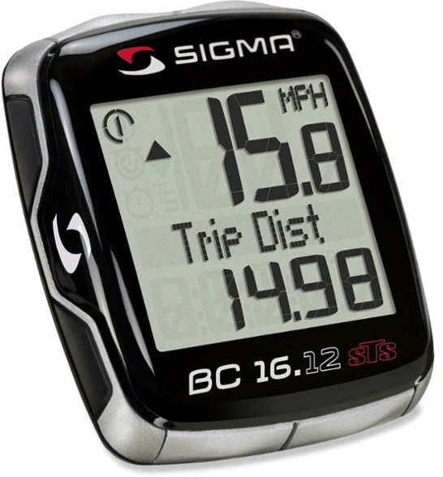
Fixed-program computers
Early computers were fixed-program computers.
A fixed-program computer is a computer that is designed to do very specific things only, like
calculating the trajectory of artilerry shells on a battleship, or
breaking the Enigma code (by Alan Turing),
Changing the program of a fixed-program machine, requires rewriting, restructuring or redesigning the machine.
Fixed-program computers are still in use nowadays.
(e.g. Sigma bicycle computer)

Slide 24
Stored-program computers
Most modern computers are stored-program computers.
A stored-program computer stores (and manipulates) a sequence of instructions, and has a set of elements that will execute any instruction in that sequence.
By treating those instructions in the same way as data, a stored-program machine can easily change the program, and can do so under program control.

Slide 25
Stored-program computer architecture
COMPUTER
MEMORY
INPUT
OUTPUT
CPU
CONTROL UNIT
ARITHMETIC LOGIC UNIT
* von Neumann architecture (model)

Slide 26
Hardware and software

Slide 27
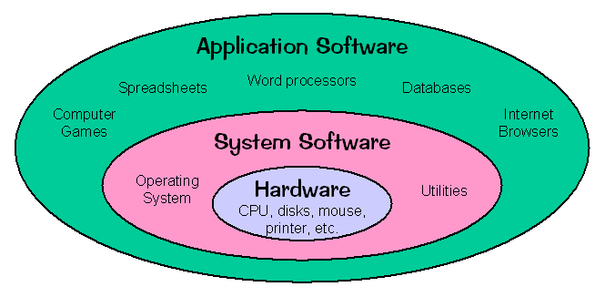
Hardware and software
Every computer consists of:
Hardware
Software
System software
Programming software
Application software
Notes:
Note: some authors make distinction between system and programming software (which is why programming software is given in italics), while others treat programming software as part of system software.

Slide 28
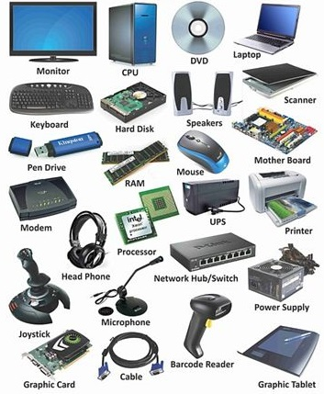
Hardware
Physical, tangible parts or components of computer.
CPU – central processing unit
Motherboard
Memory
Keyboard
Mouse
Monitor
Graphic card
Sound card
Speakers
…

Slide 29
Software
Software is a set of instructions, data or programs used to operate computers and execute specific tasks.
In addition to hardware, which is a physical aspect of computer, software is a generic term used to refer to applications, scripts and programs that run on a device.

Slide 30
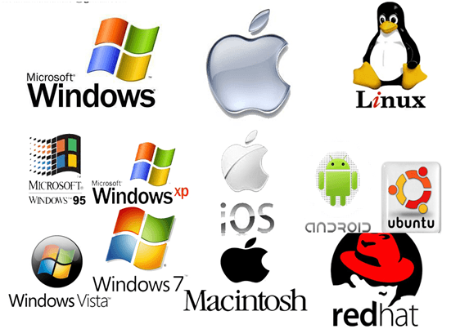
System software
System software is a type of computer program that is designed to run a computer’s hardware and application programs.
Interface between the hardware and user applications.
System software includes operating systems AND all utility programs (e.g. drivers) that are essential for the successful running of the computer itself.

Slide 31
Programming software
Programming software is a program that helps programmer in developing other software.
Helps programmer in software:
Creating
Debugging
Maintaining
Also known as “programming tool” or “software developing tool”.
Programming software:
Compilers
Assemblers
Debuggers
Interpreters
Integrated development environments – IDE, combine all of the above.
Notes:
Note: some sources treat programming software as separate category. Others, view them as sub-part of system software.

Slide 32
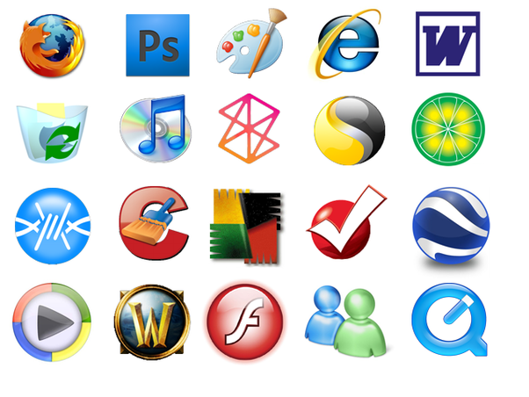
Application software
A collection of programs used by end users.
A software developed to help user perform a specific task.

Slide 33
Analog vs Digital

Slide 34
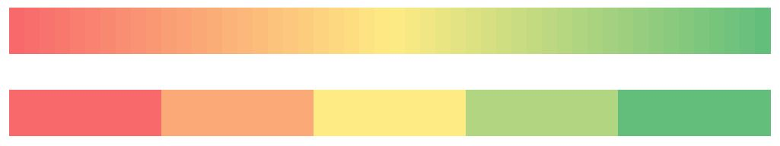
Analog and digital
Terms analog and digital refer to the way we represent information; more precisely, some signal.
Analog – continuous signal.
Digital – sequence of 1’s and 0’s.
An analog signal is continuous, while in a digital signal there are always “steps”.

Slide 35

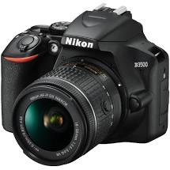
Analog and digital (camera example)
Old cameras used analog technology (film, negative, optics, chemical reactions) to store pictures.
Today’s cameras use optics to pass information to digital sensors that consist of a huge number of miniature photo-sensitive elements; each representing one pixel of an image. Thus converting light into a sequence of colored dots (each represented by number).

Slide 36
Analog and digital
In a digital world we can view something as black or white.
In an analog world, besides black and white there are always shades of gray.
When copying, a digital signal doesn’t degrade. It remains the same – always the same sequence of 1’s and 0’s. Every copy is identical to the original.
An analog signal deteriorates in quality after copying. Continuing the process further deteriorates the signal.
Example: copying DVD and copying VHS tape.

Slide 37
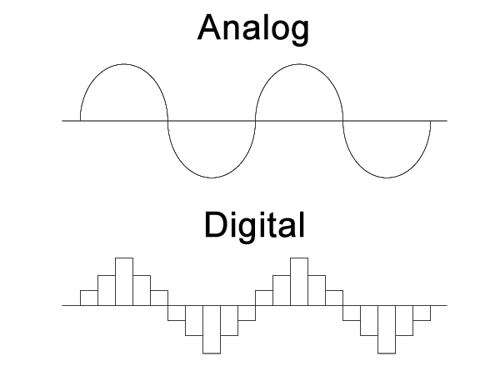
Analog and digital
Analog signals can be converted to digital.
This process will always have some loss of quality.
The advancement of technology makes digital more precise, but will always remain limited by memory, technology, etc.

Slide 38

Analog and digital (example)
Let’s consider a game …
Two students (Bob and Alice) have to color a picture.
Alice is coloring and Bob tells her which color to use.
They are not allowed to talk.
They can use cell phone to communicate color.

Slide 39
Analog and digital (example)
Assuming that Alice can perfectly recognize each color, she can easily make a mistake between similar shades.
Also, additional factors can influence Alice to pick a wrong color:
The further Bob is, the more difficult it is to recognize the color.
If the room is lit or dark may also cause wrong color interpretation.
Other elements in the room (e.g. vapor)
The above factors represent a “noise”.
Every analog signal is susceptible to noise.

Slide 40
Analog and digital (example)
What can be done to improve the situation?

Slide 41
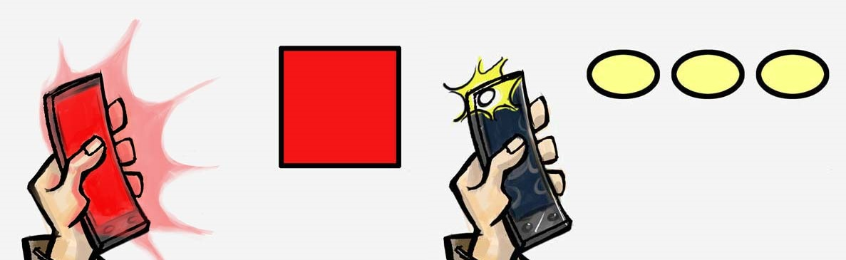
Analog and digital (example 2)
Bob and Alice decided to change the way they communicate.
Bob has switched off his screen and is now using LED to blink information about color and he is flashing that information in short intervals.
They agreed that the number of flashes represents certain color (e.g. 1 flash for black, 3 for green, 7 for yellow, etc.).

Slide 42
Analog and digital (example 2)
By changing the way of communicating, Bob and Alice achieved:
The distance is no longer a problem, as long as Alice can see the flash.
The noise in the room can no longer interfere (as Alice only needs to count flashes, not determine their color)
Essentially, Bob and Alice now send a digital signal, preventing the loss of information.
All is not ideal – the medium of communication (light) has not changed. In case of physical obstruction or if Bob goes too far, the communication will no longer be possible.

Slide 43
Analog and digital (example 2)
The second problem is the introduction of ENCODING / DECODING.
Bob and Alice must agree on the table of colors and associate number with each.
Before sending Bob must ENCODE the color into the number of flashes.
Alice must count the flashed and DECODE the number into desired color.
In this example Bob is performing A/D conversion while Alice is performing D/A conversion.

Slide 44
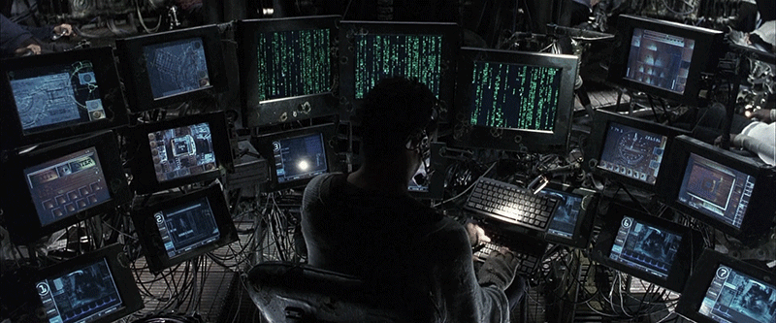
Analog and digital
Computers natively store and manipulate information in digital form.
Humans natively store and manipulate information in analog form.
Note: Every image on the screen is a sequence of numbers. To understand it, we must decode it.

Slide 45
Analog and digital (example 2)
Discussion: What advantages / disadvantages do you see by communicating via digital signal?

Slide 46
Analog and digital (example 2)
Discussion: What advantages / disadvantages do you see by communicating via digital signal?
Advantage: lossless transmission of a signal.
Disadvantage(s):
Time
(Bob has to send and Alice has to count flashed; even if super-fast, instead of showing information at a glance as with analog approach, digital form will take much more time)
The amount of information
(Bob and Alice must agree on a table. If a color is not in the table it cannot be sent, and the closest one must be picked. Increasing the size of table will require more flashes to be sent, thus more time and more data.)

Slide 47
Analog and digital
Conclusion:
By using information in digital format, we minimize the risk of information loss.
If the digitization we use has to be more precise, we need a (much) larger amount of information.
Once a digital channel for commutation is established, it can be used to transmit any kind of information. Bob and Alice can also use the same method to transmit text, sound, etc.

Slide 48
Summary Quiz
What is computation?
How do we define data?
What is information?
What is information science?
What is informatics?
What are the key characteristics of information systems?
Why are those characteristics so important?
What is computer science?
What are the fundamental operations of any device we define as computer?
What is the key difference between a fixed-program computer and a stored-program computer?
List elements of von Neumann architecture.

Slide 49
Summary Quiz
What is hardware?
What is software?
What is the difference between system and application software?
What is the difference between analog and digital signal?
How do we call the process of converting the analog to the digital signal?
What is gained and lost in the process (of converting signal)?
What type of information storing is native for humans?
What type of information storing is native for machines?
What are the benefits and disbenefits of storing information in a analog and digital form?

Slide 50
Summary
Computation is a general term for any type of information processing. It is a process following a well-defined model that is understood and can be expressed in an algorithm, protocol, network topology, etc.
Data is defined as a representation of facts, concepts, or instructions in a formalized manner, suitable for communication, interpretation, or processing by a human or a computer.
Information is the processed data that is i) accurate and timely, ii) specific and organized for a purpose, iii) presented within a context that gives it meaning and relevance, and iv) can lead to an increase in understanding and decrease in uncertainty.
Information science is a scientific field that studies information systems and information-related activities such as information: analysis, collection, classification, storage, transfer, manipulation, dissemination and protection.
Informatics is an applied form of information science.

Slide 51
Summary
The key characteristics of information systems are its abilities to acquire, transform and exchange information.
The key characteristic of information systems are the base requirements of any technological advancement.
Computer science is a set of skills and technologies focusing on development, programming and use of computers. Computer science deals with all practical activities related to information.
The fundamental operations of every computer are its ability to: i) input information, ii) store information, iii) process information, and iv) output information.
The key difference between a fixed-program computer and a stored-program computer is that the first one is designed to do only very specific things, and that changing its program would require rewriting, restructuring or redesigning the machine. On the other hand, a stored-program computer stores (and manipulates) a sequence of instructions, and has a set of elements that will execute any instruction in that sequence. By treating those instructions in the same way as data, a stored-program machine can easily change the program.

Slide 52
Summary
The elements of von Neumann model include: i) input, ii) output, and the computer, consisting of iii) memory and iv) central processing unit, which contains: iv-a) control unit and iv-b) arithmetic logic unit.
Hardware - physical, tangible parts or components of computer.
Software – a set of instructions, data or programs used to operate computer and execute specific tasks.
System software is designed to run a computer’s hardware and application programs. Application software is a collection of programs used by end users that help them perform a specific task.
Analog signal are continuous while digital signals are always in “steps”.
Digitization is the process of converting analog to digital signals (information).
Using digitization we prevent the loss of information. As a consequence, more space and time is required to store and transmit the same information.

Slide 53
Summary
Humans natively store and manipulate information in analog form.
Computers natively store and manipulate information in digital form.
The analog form is native for humans and as such will always be present. The digital form is likely to dominate in the future. Analog used to be more accurate, consumed less space and could be transmitted faster than the digital form, but with improvement of the technology that difference diminished. The digital information is resistant to noise and can be copied without quality degradation.

Slide 54
Extra material - videos
Disclaimer:
The following videos are not part of the course material, and as such, are treated as an extra information. The teaching team believes it is beneficial to the students to also have the topics presented from a different perspective. Some video will provide more information that given at the lesson, some less.
For the exam, the only relevant information is considered the one given by the teachers and written in the course book.
To understand the topics better, using external sources, like the videos given below, is strongly recommended. Feel free to explore, and ask your teacher should you have any questions.

Slide 55
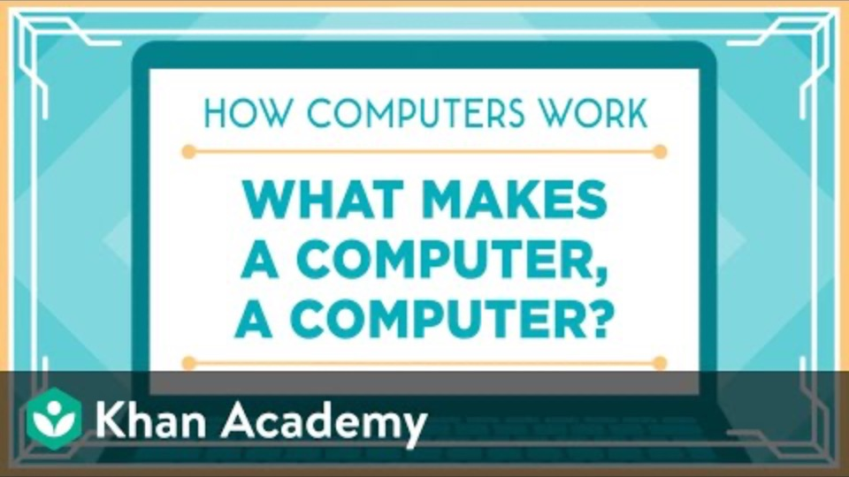
What is a computer … ?
Notes:
URL:
https://www.youtube.com/watch?v=xfKn5OjHLqQ

Slide 56
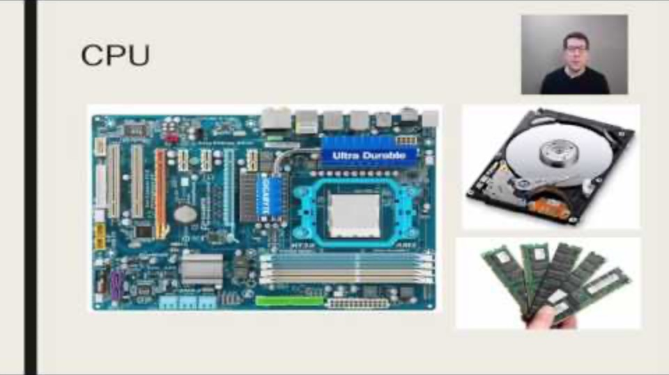
von Neumann architecture
Notes:
URL:
https://www.youtube.com/watch?v=JAH2WtmXBhI

Slide 57
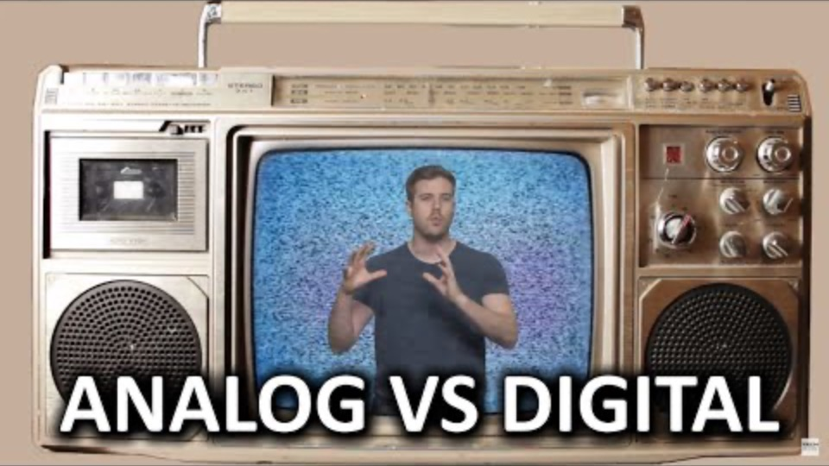
Analog vs Digital
Notes:
URL:
https://www.youtube.com/watch?v=btgAUdbj85E

